Slide 1
Initial Investigation
Start with technical” SEO audit (which you can do with almost any SEO site audit tool).
Ex: Moz, PageSpeed Insights, gtmetrix etc.
Step 1
Title Tag
You have a title tag of optimal length (between 10 and 70 characters). Length : 45
Meta Description Tag
Your page has a meta description tag however, your meta description should ideally be between 70 and 320 characters (including spaces). Length : 327
A meta description is important for search engines to understand the content of your page and is often shown as the description text blurb in search results.
H1 Header Tag Usage
Your page does not have an H1 Header Tag.
The H1 Header Tag is an important way of signaling to search engines what your content is about, and subsequently the keywords it should rank for.

Slide 2

H1 Header Tag Usage
Your page does not have an H1 Header Tag.
The H1 Header Tag is an important way of signaling to search engines what your content is about, and subsequently the keywords it should rank for.
H2-H6 Header Tag Usage
Your page is making use multiple levels of Header Tags.
Keyword Consistency
Your page's main keywords are not distributed well across the important HTML tags.
Your page content should be focused on keywords you would like to rank for. Ideally these keywords should also be distributed across tags such as the title, meta and header tags.
Keyword | Title | Meta Description Tag | Headings Tags | Page Frequency
bike |  |  |  | 11
now |  |  |  | 9
shop |  |  |  | 8

Slide 3
Amount of Content
Your page has a low volume of text content which search engines can interpret as 'thin content'. Word Count: 464
It has been well researched that higher text content volumes are related to better ranking ability in general.
Image Alt Attributes
You have images on your page that are missing Alt attributes. We found 77 images on your page and 31 of them are missing the attribute. Alt attributes are an often overlooked and simple way to signal to Search Engines what an image is about, and help it rank in image search results.
Show details

Slide 4
Step 2 : Rankings
Top Keyword Rankings
This shows your top 10 Keyword Rankings in the specific location. The list is ordered by the keywords that drive the most traffic to your page.
Keyword | Country | Position | Total Searches | Estimated Traffic
honda monkey accessories | EN | 1 | 1,000 | 304
honda monkey accessories | ES | 1 | 1,000 | 304
Total Traffic From Search
This shows you the Estimated Traffic Volume your page receives from it’s Keyword Rankings
21,941
Monthly Traffic Volume

Slide 5
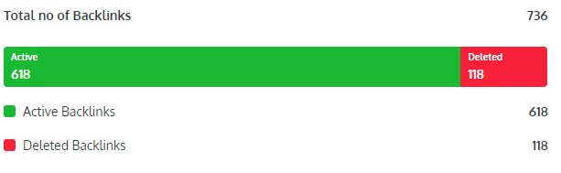
Step 3 : Links
Number of Backlinks
Check The quality and quantity of your backlinks can help you rank higher in search engines such as Google and Bing.
Friendly Links
Some of your link URLs do not appear friendly to humans or search engines. We would recommend making URLs as readable as possible by reducing length, file names, code strings and special characters.

Slide 6
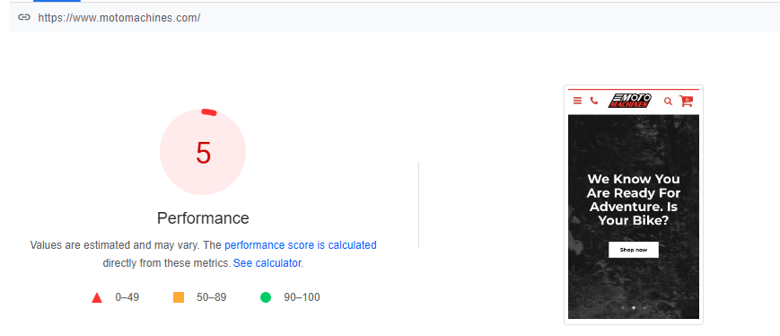
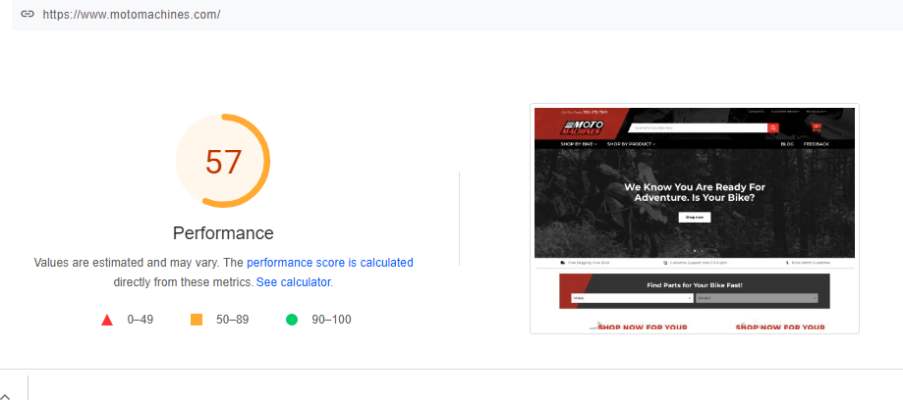
Step 4: Usability
This check visually demonstrates how your page renders on different devices. It is important that your page is optimized for mobile and tablet experiences as today the majority of web traffic comes from these sources.
Use Pagespeed Insight
Mobile 5% low Desktop: 57
Google's Core Web Vitals
Your page has failed Google's Core Web Vitals assessment.Core Web Vitals are UI metrics that Google considers important in a visitor's 'page experience' and have subsequently become a ranking factor. They assess the appearance of content, interactivity of the page and visual stability from the moment of page load.
Legible Font Sizes
There is some text on your page that is small and may not be legible enough for particular users.We recommend reviewing all text on your page in different devices to ensure that it is of appropriate size.

Slide 7
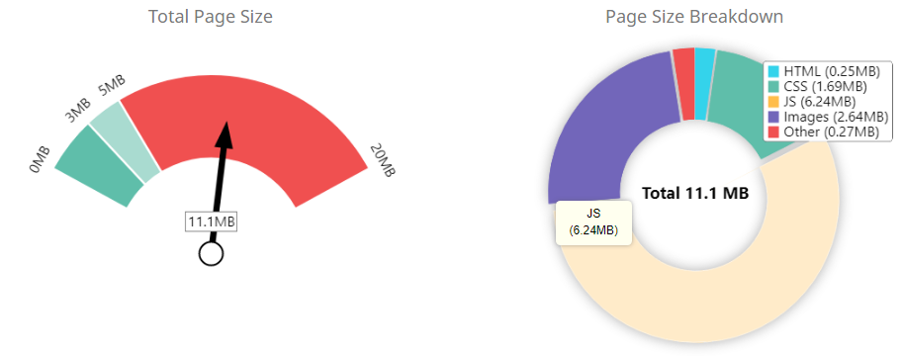
Step 5: Performance Results
Page Size Info
Your page's file size is quite large which, regardless of other optimizations, can reduce load speed and impact user experience. A general rule is to keep your page under 5MB in total file size.
Our: 11.1 Mb
Minification
Some of your JavaScript or CSS files do not appear to be minified. Minification is a reasonably simple way to reduce page size, and subsequently load time.
Inline Styles
Your page appears to be using inline styles. Inline styles are an older coding practice and discouraged in favor of using CSS style sheets, due to their ability to degrade page load performance and unnecessarily complicate HTML Code.

Slide 8
Step 5: Social Results
Twitter Activity
You have a low level of followers on Twitter. 67Followers
LinkedIn Connected
No associated LinkedIn profile found linked on your page.

Slide 9
Thank You

